Slide 1
Resolution of a Force into a Force and Couple
Dr. Jacob Moore
Associate Professor of Engineering
Penn State Mont Alto

Slide 2
Resolution of a Force into a Force and a Couple
When we resolve a force into a force and a couple, we are finding a force and a moment that are statically equivalent to the original force.
This allows us to shift the point of application of the force from some original point to some new point of interest.
If we shift a bunch of forces to a single point, we can simply add the forces and moments to find the equivalent force couple system.

Slide 3




Resolution of a Force into a Force and a Couple
Imagine we have a force acting on a wrench as shown below.
We might want to imagine the force’s effect on the bolt it is turning.
To do this we could resolve the force into a force and a couple (pure moment) acting about the center of the bolt.
$$M_{eq}$$
Y
$$F$$
X
$$F_{eq}$$

Slide 4
Resolution of a Force into a Force and a Couple
To visualize the process resolving a force into a statically equivalent force and couple, we can imagine the following.
Draw a free body diagram with the original forces.
Pick a point that we want to have the equivalent force and couple act about.
Y
$$F$$
d
X

Slide 5


Resolution of a Force into a Force and a Couple
Imagine drawing in two equal and opposite forces at this point.
One will be acting with the same magnitude and the same direction as the original force, the other will have the same magnitude but the opposite direction of the original force.
We are adding two equal and opposite forces, so this is essentially like adding zero to an equation, it will not change anything.
$$−F$$
Y
$$F$$
$$F$$
d
X

Slide 6

Resolution of a Force into a Force and a Couple
Two of these forces will form a couple.
This couple can be redrawn as a moment.
This will leave a single force and a single moment acting on the body.
$$−F$$
$$M_{eq}$$
Y
$$F$$
$$F$$
d
X

Slide 7
Resolution of a Force into a Force and a Couple
As a shortcut, to the equivalent force couple system.
The force in the equivalent force couple system will have the same magnitude and direction as the original force.
The couple (or pure moment) will be equal to the moment that the original force exerts about that point.
$$M_{eq}$$
Y
$$F$$
X
$$F_{eq}$$

Slide 8
Thanks for Watching
See other engineering mechanics videos and access the full tool at…

Slide 9
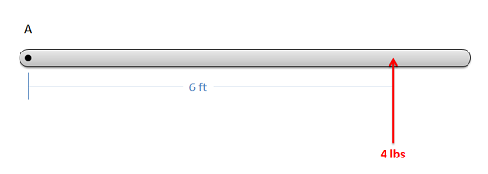
Resolving a Force Worked Example
Resolve the force shown below into a force and couple acting at point A.

Slide 10
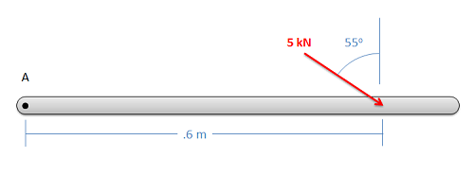
Resolving a Force Worked Example
Resolve the force shown below into a force and couple acting at point A.

Slide 11
Resolving a Force Worked Example
Resolve the force shown below into a force and a couple about point A.
4 ft
4 ft
Mont Alto PA Next Left
3 ft
A
300 lbs

